Slide 1
Sequential circuits

Slide 2
Sequential circuits
Sequential Circuit Models
Latches
Flip-Flops

Slide 3
Sequential circuits
The main characteristic of combinational logic circuits is that their output values depend on their present input values.
Sequential logic circuits differ from combinational logic circuits because they contain memory elements so that their output values depend on both present and past input values.

Slide 4
Sequential circuits
Sequential circuits can be Synchronous or Asynchronous.
  Synchronous sequential circuits change their states and output values at fixed points of time, i.e. clock signals.
  Asynchronous sequential circuits change their states and output values whenever a change in input values occurs.
  Asynchronous sequential circuit: circuit output can change at any time (clockless).

Slide 5
Latch vs flip-flop
A Latch or Flip-flop is use to store one bit of information.
Latches: Latches are “transparent” (= any change on the inputs is seen at the outputs immediately).
This causes synchronization problems.
A latch has two stages set and reset.
Set stage sets the output to 1.
Reset stage set the output to 0 (Clear to 0).
Flip-flops : A flip-flop is a memory device that has clock signals control the state of the device.
Clocked sequential circuit (Synchronous).

Slide 6
Types of Flip flops
SR Flip-Flop
D Flip-Flop
JK Flip-Flop
T Flip-Flop

Slide 7
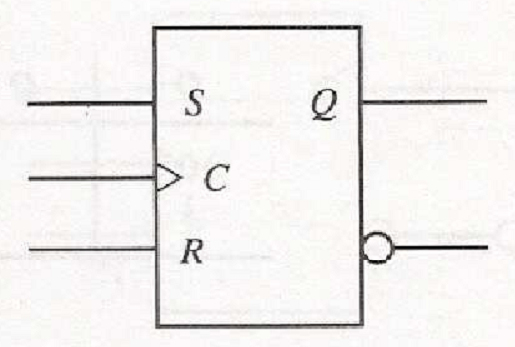
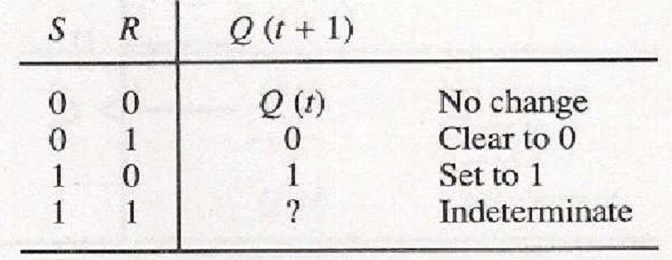
SR (Set-Reset) Flip-flop
SR Flip-Flop has three inputs, S (for set), R (for reset), and C (for Clock).
It has an output Q.
Fig: Characteristic Table
Fig: Graphic symbol
Rarely used due to indeterminate condition.

Slide 8
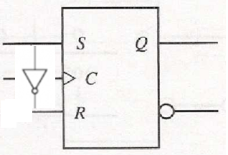
D (Data) Flip-flop
D Flip-Flop is a slight modification of SR flip-flop.
D Flip-Flop is created by inserting an inverter between S and R.
D
Fig: SR flip-flop
Fig: D flip-flop

Slide 9
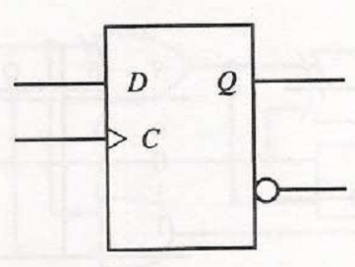
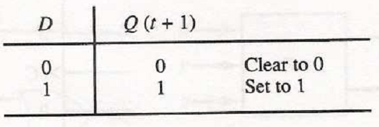
D (Data) Flip-flop
Fig: Characteristic Table
Fig: Graphic symbol
The output of the D flip-flop is determined by input D.
The output can be expressed by
Q(t+1)=D
No input condition exists for unchanged and indeterminate.

Slide 10
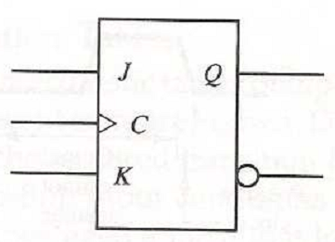
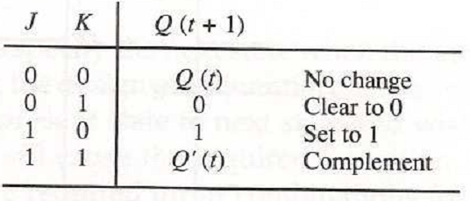
JK (Jack-Kilby) Flip-flop
JK Flip-Flop is a refinement of SR flip-flop.
When inputs J and K are both equal to 1, it complement the state.
Fig: Graphic symbol
Fig: Characteristic Table

Slide 11
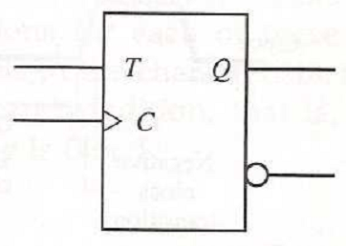
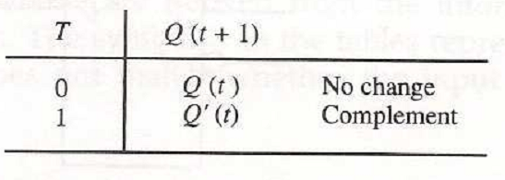
T(Toggle) Flip-flop
T Flip-Flop is a slight modification of JK flip-flop.
Input JK are connected to provide a single input by T.
Only has two input conditions T=0 (J=K=0) and T=1 (J=K=1).
The output can be expressed by Q(t+1)=Q(t) ⊕ T.
Fig: Graphic symbol
Fig: Characteristic Table

